Slide 1


INFORMATION SECURITY
LECTURE 6
Dr. Muhammad Umar Aftab

Slide 2

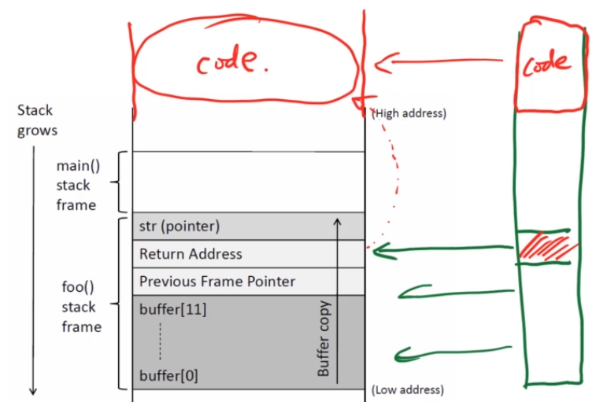
Challenges
  foo() copies data in the buffer and it will overflow
  Buffer overflow writes the data or over load the data in the return address section.
  Let the program return to our code.
  Our job is to call foo() to return to our code.

Slide 3
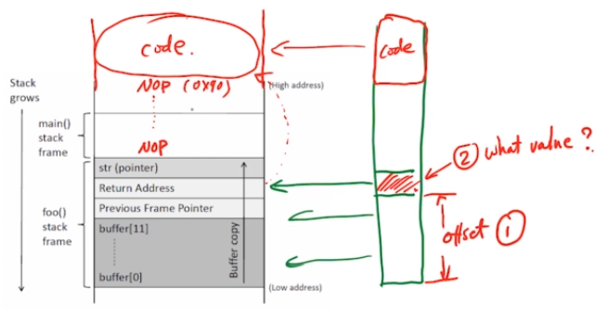
Challenges
  There are two challenges that we have to face
    Where we put the return address?
      What is the offset?
    What value we put into the address?
      The value should be the beginning of our code.
      Because we don’t know, what is the starting point of our code. Where our code placed in the stack?
  By creating multiple entry points, we can increase the chances of guesses.
  So that we can enter in our code from multiple
  points.
  How can we increase multiple entry points?
  We can place a lot of NOP
    So our success rate will also increase
Notes:
In computer science, a NOP, no-op, or NOOP (pronounced "no op"; short for no operation) is a machine language instruction and its assembly language mnemonic, programming language statement, or computer protocol command that does nothing.
A function or a sequence of programming language statements is a NOP or null statement if it has no effect. Null statements may be required by the by the syntax of some languages in certain contexts.

Slide 4
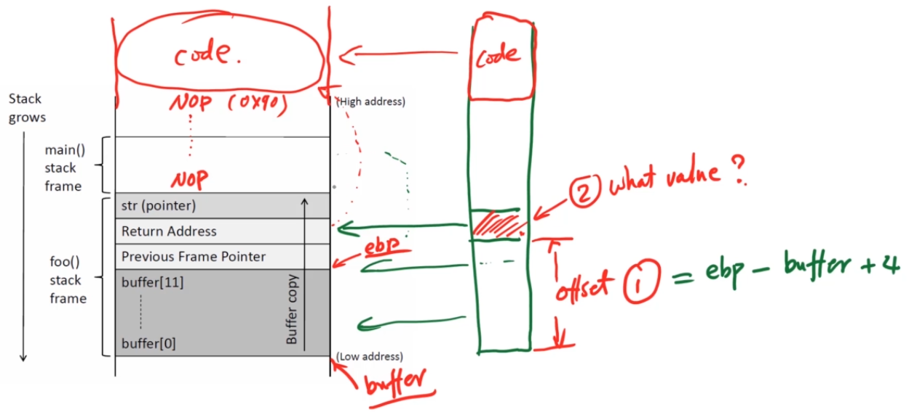
Challenges
  We have to figure out one of the issue.
  Now, if we get the ebp value and address of the buffer then we can get the offset value.
  Further we have to plus some values in the ebp value so that we can reach to one of the NOP values.

Slide 5
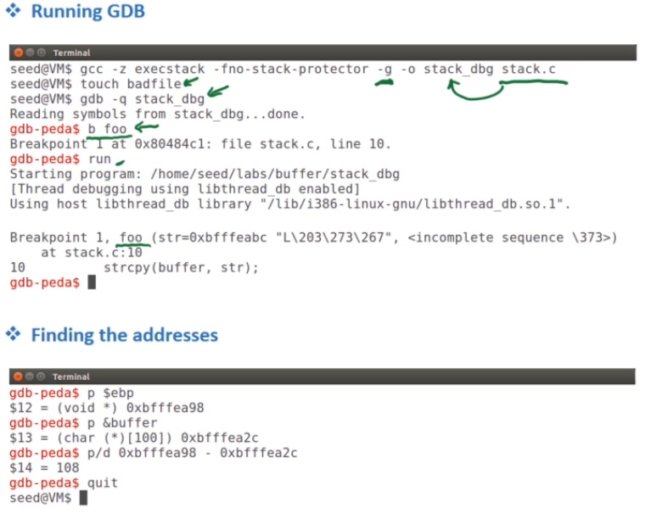
Finding Offset and Addresses
  In this experiment, we assume that we have the source code.
  We are running this code for debugging.
    We need to set a breakpoint
    We can stop the program during execution then we can print-out some of the variables.
    When foo() invoked then program will stop.
    Make sure, when you run the program the bad file should exists.
      So create badfile before running GDB
    Program run and stop inside the foo().
    Stop program: Print value of ebp & buffer
Notes:
GDB is the acronym for GNU Debugger. This tool helps to debug the programs written in C, C++, Ada, Fortran, etc. The console can be opened using the gdb command on terminal.

Slide 6
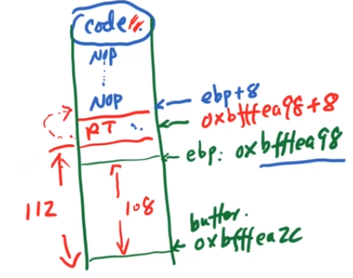
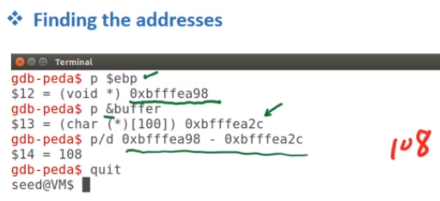
Finding Offset and Addresses
  Use p command to print the values of ebp and buffer
  p/d to get the difference of these numbers/ addresses
  So offset = 108
  That give us the idea “what will be the candidate value of return address (R.T)”
  So, we need to return one of our NOP.
  So ebp+8 is the candidate for R.T
  Note: In our example/Attack, we are not using ebp+8 for
  R.T, May be we use +100, +120 etc.
  Depends upon the scenario of experiment

Slide 7
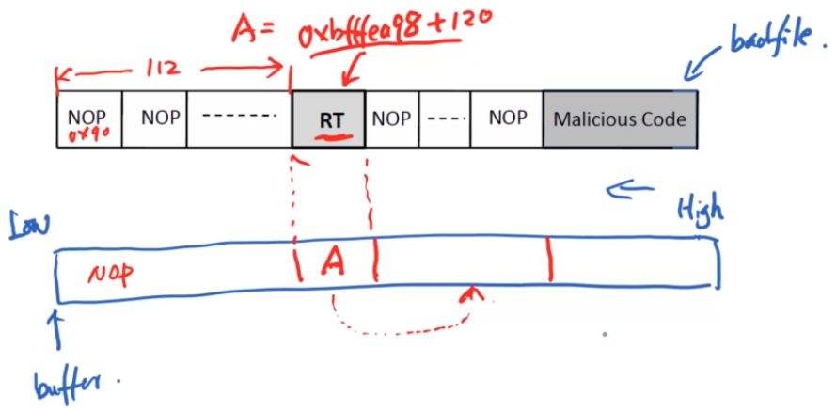
Construct the Payload/ Input (badfile)
  Construct the badfile and copy in the stack
  At the end of badfile, we put our malicious code.
  We need to make sure the ‘A’ must be in NOP range
  So, we need to create badfile and put the return address at a particular location.
  Everything is at our side → overflow the buffer then our code will be triggered.
  Remember: string copy () stops at 0.
  Inside our payload, we should not have any 0 but the return address may have.

Slide 8
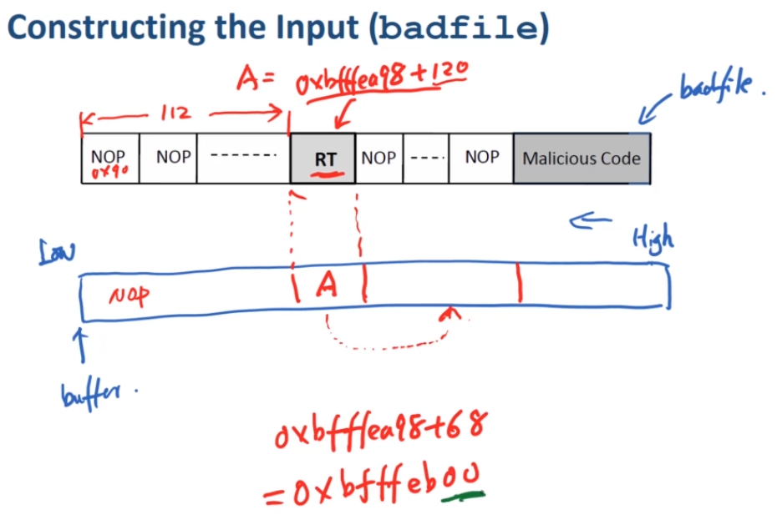
Construct the Payload/ Input (badfile)
  If strcpy() see 0 then it will stop coping that will stop your attack.

Slide 9
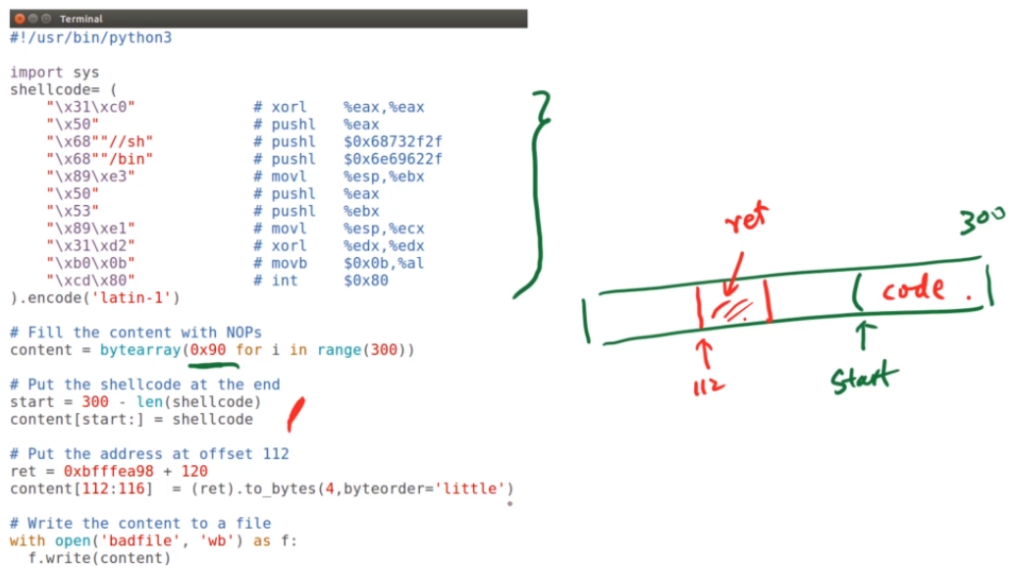
Exploit code
  Machine code put inside the shell code.
  Once your code is ready then put into the badfile and Launch the Attack

Slide 10
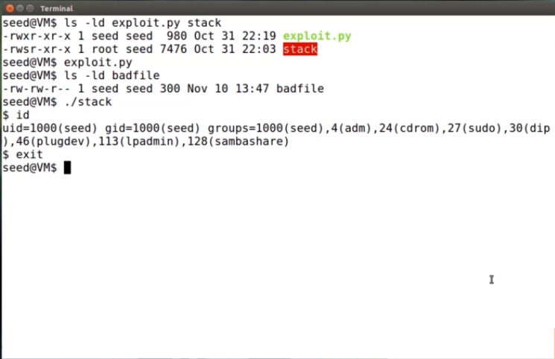
Exploit code
  Ready exploit.py and stack program.
  Run exploit.py→ generate badfile
  Run stack → get the shell but not root shell
  By checking id , we can see that we don’t have root privileged → Something went wrong

Slide 11
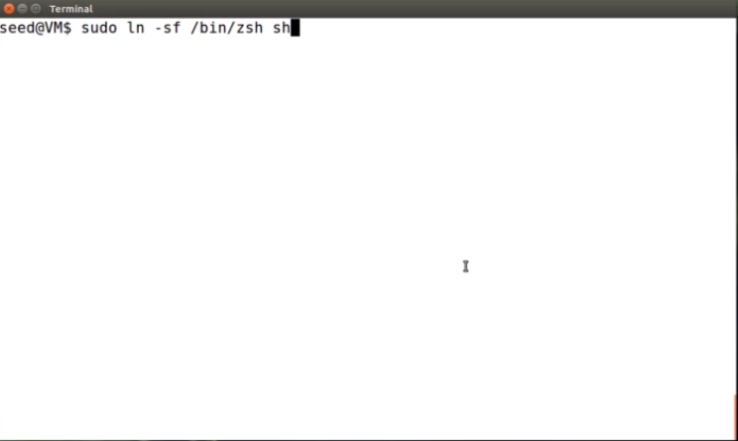
Countermeasure Issue
  Issue: one of the countermeasure in the linux OS.
  So we have change that shall program does not have countermeasure.
  Link sh with zsh.
  Now, do the attack again.

Slide 12
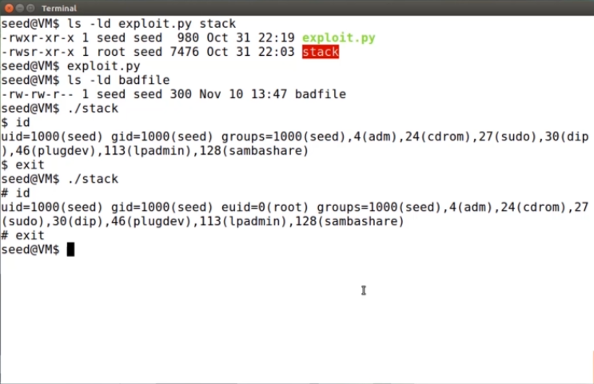
Exploit code
  Run the stack → the sign change $ to # (Indication of Root)
  Check id → euid=0

Slide 13
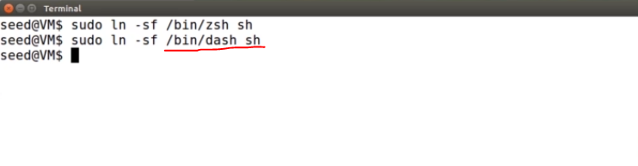
Countermeasure
  Revert the countermeasure → because many other things depend on it.

Slide 14


